Slide 1
EMERGING METHODS FOR EARLY DETECTION OF FOREST FIRES
NALAIYA THIRAN PROJECT
IBM–PROJECT–9144-1658983281
TEAM ID: PNT2022TMID38040
Submitted by
J.NANDHINI | 411519104053
P.BABY SWETHA | 411519104007
V.KEERTHANA | 411519104035
M.MAREESWARI | 411519104046
K.DAYANA | 411519104012

Slide 2
OBJECTIVES
Forest fires are natural phenomena that occur regularly on earth, a large quantity of forest area and wildlife are destroyed annually due to the forest fires. It causes drastic loss of lives and valuable natural resources and individual properties.
The forest fire has significant effects on the global climate. The problem has become more severe than previous years. The human encroachment over forest areas is a major cause of forest fire. It is very essential to detect and avoid the fire at its initial state itself.
Traditional fire protection methods use mechanical devices or humans to monitor the surroundings. The most frequently used fire smoke detection techniques are usually based on air transparency testing, particle sampling, and temperature sampling. An alarm is not raised unless the particles reach the sensors and activate them.
The huge leap in image processing technology and the reduced cost of digital cameras make fire detection based on image processing more feasible than any other traditional methods like fire watch towers, sensors, satellites etc.

Slide 3
EXISTING SYSTEM
Existing systems include Fire and Hazard Detection systems which employ heat sensors or temperature sensors or smoke sensors or a combination of these. These are installed at heights which are usually floor level (or ceiling level).
These contain individual sensors which are not lined together, which leads to unpredictability and nonsynchronous behavior of alarm.
A smoke detector is a device that senses smoke, typically as an indicator of fire. Fire alarm system known as smoke alarms, generally issue a local audible or visual alarm on detection of smoke. Generally, fire alarm consists of smoke detectors with a basic assumption that smoke will be generated by the fire.
If we detect smoke, then the fire is detected. Even if there is any fire, the smoke may be generated quite later after burning the surroundings. For some fires, smoke may not be generated or it takes long time for the smoke detectors to detect the smoke.

Slide 4
DISADVANTAGES
Manual analysis of fire detection
Need additional sensors to detect fire
Time complexity is high
Accuracy is less
Irrelevant features are extracted

Slide 5
PROPOSED SYSTEM
In this project proposing a system which automatically detects the presence of fire based on the deep learning algorithm. Deep learning is a branch of machine learning that depends entirely on neural networks, as the neural network will simulate the human brain, so deep learning is also a kind of simulation of the human mind.
In this proposed system we can implement preprocessing steps to eliminate the noises in images. And also implement features extraction to extract the color features and segment the fire regions. Finally classify the pixels using deep learning algorithm with efficient mobile alert system to corresponding authorities.

Slide 6
ADVANTAGES
Automated analysis of fire detection
Reduce the time and computational complexity
Relevant features are extraction
Improved accuracy rate

Slide 7
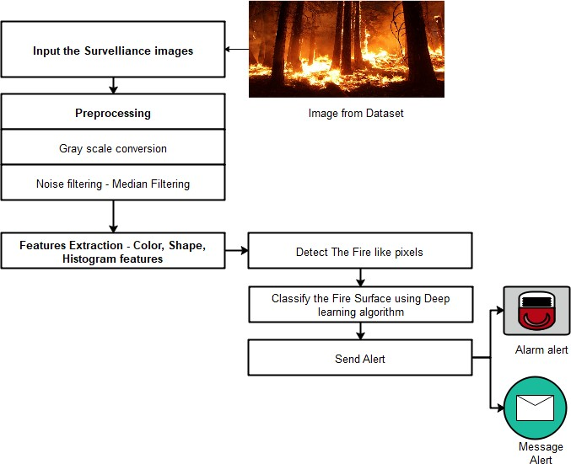
SYSTEM ARCHITECTURE

Slide 8
HARDWARE REQUIREMENTS
Processor : Intel core processor 2.6.0 GHZ
RAM : 4GB
Hard disk : 512 GB
Compact Disk : 650 Mb
Keyboard : Standard keyboard
Monitor : 15 inch color monitor

Slide 9
SOFTWARE REQUIREMENTS
Operating system : Windows 10
Front End : C#.NET
Back End : SQL SERVER
IDE : PYCHARM

Slide 10
MODULES
Image Set Upload
Median Filtering
Color Features Extraction
Fire Recognition
Alert System

Slide 11
IMAGE SET UPLOAD
In this module, we can upload the image or videos which are captured from CCTV footages in forest. The satellite sensor is used to capture the forest fire image, but it has an increasing range of time resolution and space of the forest area.
Satellite images also gave a fire-monitoring tool, management, and finding the damaged tool for compliance with burn areas to understand a favorable fire range
The principle of classifying this fire, such as materials from the original fire, is to check the color consistency. The proposed algorithm has rectified this problem and reduces the error. It not only detects fires but also distinguishes fires such as fire and materials.
The parameters that were adopted in our proposed system operation to analyze the forest fire, threshold value, the detection of matrix value, and the differential matrix value of the system. If the input is video means, convert the videos into frames or if the input is images means, it can be any format or size

Slide 12
MEDIAN FILTERING
Pre-processing is a common name for operations with images at the lowest level of abstraction both input and output are intensity images.
These iconic images are of the same kind as the original data captured by the sensor, with an intensity image usually represented by a matrix of image function values (brightnesses).
Image pre-processing methods are classified into four categories according to the size of the pixel neighborhood that is used for the calculation of new pixel brightness.
The aim of pre-processing is an improvement of the image data that suppresses unwilling distortions or enhances some image features important for further processing, although geometric transformations of images (e.g. rotation, scaling, and translation) are classified among pre-processing methods here since similar techniques are used

Slide 13
COLOR FEATURES EXTRACTION COLOR FEATURES EXTRACTION
Feature extraction involves simplifying the amount of resources required to describe a large set of data accurately. When performing analysis of complex data one of the major problems stems from the number of variables involved.
Analysis with a large number of variables generally requires a large amount of memory and computation power or a classification algorithm which over fits the training sample and generalizes poorly to new samples. Feature extraction is a general term for methods of constructing combinations of the variables to get around these problems while still describing the data with sufficient accuracy. Texture tactile or visual characteristic of a surface.
Texture analysis aims in finding a unique way of representing the underlying characteristics of textures and represent them in some simpler but unique form, so that they can be used for robust, accurate classification and segmentation of objects

Slide 14
FIRE RECOGNITION
The classification is the final step of the system. After analyzing the structure, each section individually evaluated for the probability of true positives. Brain diseases are classified using Convolutional neural network algorithm.
CNNs represent feed-forward neural networks which encompass diverse combos of the convolutional layers, max pooling layers, and completely related layers and Take advantage of spatially neighborhood correlation by way of way of imposing a nearby connectivity pattern among neurons of adjacent layers.
Convolutional layers alternate with max pooling layers mimicking the individual of complex and clean cells in mammalian seen cortex .
A CNN includes one or extra pairs of convolution and max pooling layers and ultimately ends with completely related neural networks. The hierarchical structure of CNNs is steadily proved to be the most efficient and successful manner to analyze visible representations.
We know that CNNs can accomplish competitive and even better performance than human being in some visual problems, and its capability inspires us to study the possibility of applying CNNs for classify the disease features.

Slide 15
ALERT SYSTEM
The forests as a whole are heavily affected by human activity. The rapid growth of increasing the population and urbanization has led to the outbreak of forest regions.
Forest fire is a natural hazard to the environment and the interference of the atmosphere system; the environment affects living organisms.
Satellite imagery also provides a fire monitoring, management, and damage assessment tool for compliance with burn areas to understand a favorable fire range.
Satellite image refers to the ability of images from dataset images taken in a remote area to receive specific information. In this module, send alert to the authority in terms of SMS at the time of fire detection. It can be useful to provide earlier detection.

Slide 16

Screenshots

Slide 17


Slide 19
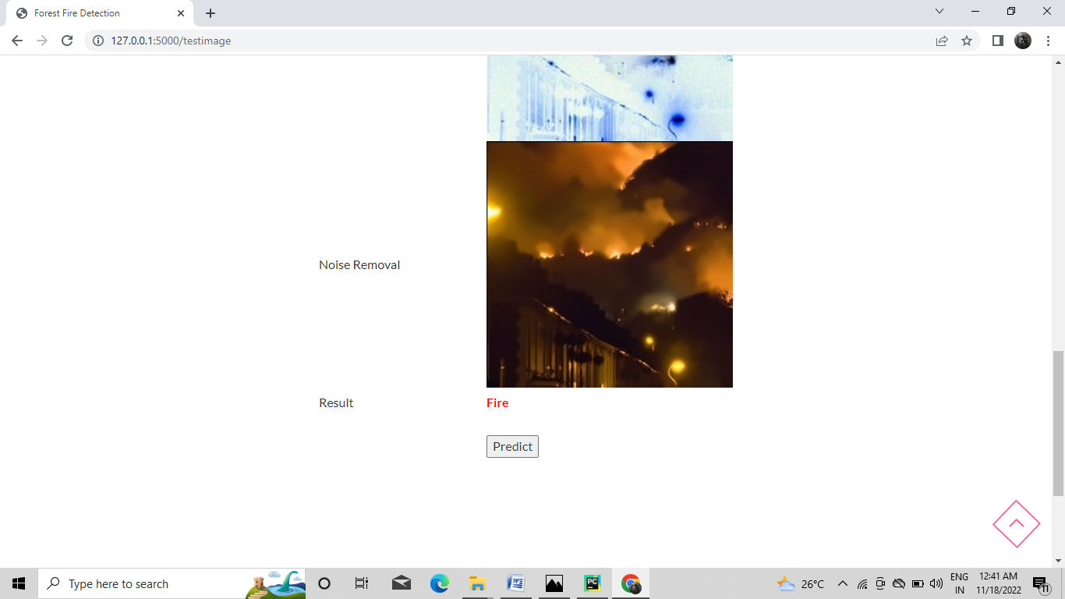

Slide 20


Slide 21
CONCLUSION
In this project, the process of the forest fire image recognition algorithm based on CNN is presented. Its main feature is that the flame image is employed for training and testing.
Then, CNN model is introduced, and an adaptive pooling method combined with color features is proposed for the problem that the traditional pooling method in Back propagation neural network (BPNN) may weaken the image features in some cases.
The effects of learning rate, batch size, and other parameters on the performance of CNN are analyzed based on experiments, and the optimal parameters are determined.
The information loss of image are avoided as adaptive pooling is adopted, and the rate of flame recognition in which fire area is segmentation than that of original image is adopted without segmentation. It is shown that the proposed algorithm has high recognition rate and is feasible.

Slide 22
FUTURE ENHANCEMENT
In future, we can extend the framework to implement various deep learning algorithms to predict fires in multiple images with improved accuracy rate.
This project can be implemented in various forest areas with additional research and innovation, helping to preserve the environment and save our forests.
If temperature and humidity sensors were added to the apparatus, it would be possible to detect fires in forests without wasting valuable trees.
In addition to serving as a haven for a wide variety of plants and animals, forests are an important source of oxygen for the ecosystem.
This project can be expanded to find an effective method of determining the fire's location, gravity, and direction,spread, burned area, and numerous others.

Slide 23
REFERENCES
[1 ] Mohammed Mustafa, “ A study on arabic sign language recognition for diferently abled using advanced machine learning classifers”,2020.
[2] Necati Cihan Camg¨oz, “: Sign language transformers: joint end-to-end sign language recognition and translation”,2021.
[3]Ankita Wadhawan, “Sign language recognition systems: a decade systematic literature review”,2020
[4] Nikolas Adaloglou “ a comprehensive study on sign language recognition methods”,2020.
[5] Dongxu li,“ transferring cross-domain knowledge for video sign language recognition”,2020

Slide 24
THANK YOU

